Slide 1

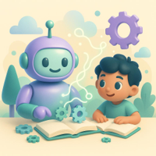
Understanding Backpropagation for Kids
How computers learn like we do, simply explained
Francisco Medina- W211144006@student.hcc.edu
Richard Rodriguez - W1428896@student.hccs.edu Rida Kashan - W217447825@hccs.student.edu Yoana Cook - W215913890@hccs.student.edu
Department of Computer Science, Houston City College Deep Learning Artificial Intel-14405 ITAI-2376
Prof. Patricia McManus
02.04.2026

Slide 2
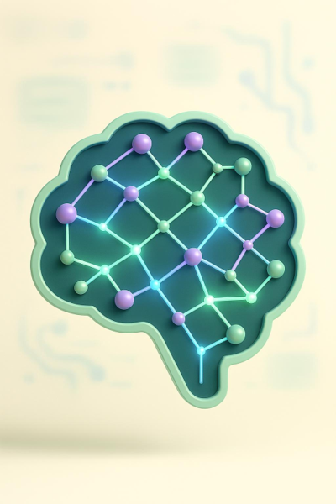
Agenda
• What Is Learning for Computers?
• Meet the Neural Network: The Computer’s Brain
• Making Mistakes and Figuring Out What Went Wrong
• Going Backwards to Get Better: The Secret of Backpropagation

Slide 3

How we learn vs How Computers learn

Slide 4
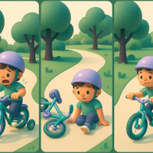
How People Learn New Things
Try, Wobble, Repeat
Beginners practice again and again, even if they wobble or fall.
Learn From Mistakes
Each attempt teaches the brain how to balance and steer better.
Confidence Through Practice
With repeated practice, riding becomes smooth, easy, and fun.
When people learn something new, like riding a bike, they try over and over again. At first, they might fall or wobble, but each time they practice, they get a little better by remembering what went wrong. This trial and error process helps their brain adjust the way it balances and moves until riding a bike becomes easy and fun.

Slide 5
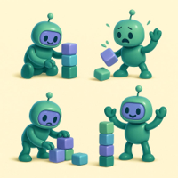
How Computers Learn Through Practice and Mistakes
Practice
The computer repeats a task many times to get better.
Mistakes and Feedback
It checks answers, notices errors, and learns from them.
Adjusting Inside
Tiny internal settings change so results improve next time.
Computers learn by trying to do a task many times and checking if their answers are right. When the computer makes a mistake, it changes little parts inside itself so it can do better next time. This process is a bit like playing a game where the computer learns the rules by trying and correcting mistakes, getting smarter each time it practices.

Slide 6
Meet the Neural Network: The Computer’s Brain

Slide 7
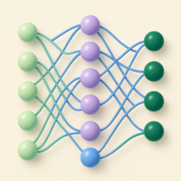
What a Neural Network Is
Web of connected nodes
Dots (nodes) send signals to one another, similar to brain cells.
Layers pass information
Input, hidden, and output layers transform signals step by step.
Recognizing patterns
By adjusting connections, the network learns to identify images and sounds.
A neural network looks like a big web of connected dots or nodes. Each dot talks to others by sending signals, just like how the brain's nerve cells work together. These connections help computers recognize patterns like pictures or sounds by passing information through layers of dots and deciding what they see or hear.

Slide 8
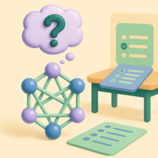
How Neural Networks Make Guesses
New input = quiz question
When it sees something unfamiliar, it makes its best guess.
Uses past learning
Connection strengths guide which answer seems most likely.
Learns from feedback
Right or wrong, it updates connections to improve next time.
When a neural network sees something new, it makes a guess about what it is, similar to trying to answer a quiz question. Sometimes the guess is right, and sometimes it's wrong. The network uses what it learned from past guesses and the strength of connections between dots to decide its answer.

Slide 9
Making Mistakes and Figuring Out What Went Wrong

Slide 10





How Computers Check Their Guesses
Guess
The computer makes a prediction based on what it has learned so far.
Compare
It checks its guess against the correct answer to see if they match.
Feedback
The computer finds out if it was right or wrong, getting a score or signal.
Improve
It uses this feedback to adjust and try to do better next time.
After making a guess, the computer compares its answer to the correct one to see if it was right or wrong. This checking step tells the computer how well it did and is very important because it guides the computer on how to fix itself and get better.

Slide 11
Understanding the 'Oops' Moment
0.75
Error = 0.75
The bigger the mistake, the more the computer adjusts its connections to improve next time.
Computers don’t just know if they're wrong, they also measure how big the mistake is. This 'Oops' moment helps the computer understand how much it needs to change to do better next time. The bigger the mistake, the more the computer adjusts its connections inside.
Notes:
Computers don’t just know if they're wrong, they also measure how big the mistake is. This 'Oops' moment helps the computer understand how much it needs to change to do better next time. The bigger the mistake, the more the computer adjusts its connections inside.

Slide 12
Backpropagation: Learning by Going Backward

Slide 13
How Computers Look Back to Fix Errors
Backpropagation is like the computer rewinding its steps to find which parts made the biggest mistakes. It traces back through the network connections to learn exactly where it needs to change to improve future guesses.
01
Forward Pass
The computer makes a prediction by moving input data through the neural network layers.
02
Error Calculation
It compares the prediction to the actual answer and calculates the error.
03
Backward Pass (Backpropagation)
The computer traces back through each layer, adjusting connections to reduce the error for future predictions.

Slide 14
Fixing Mistakes Step by Step
01
Find Where Errors Happen
Identify which connections led to the mistake.
02
Apply Tiny Adjustments
Nudge connection strengths slightly, not drastically.
03
Check Progress Each Step
After every update, measure if results improve.
04
Keep Changes Stable
Avoid big jumps that could cause confusion.
05
Grow Gradually Over Time
Connection strength improves step by step (0.50 → 0.60).
Notes:
Once the computer knows where the mistakes happened, it changes its connections just a little bit at a time. These small fixes help the computer slowly get better without making big jumps that might confuse it.

Slide 15
Trying Again and Getting Smarter
98%
accuracy after repeated learning cycles
Practice, check, fix, and improve—each try boosts performance.
The computer keeps practicing by making guesses, checking mistakes, and fixing itself over and over. Each new try helps it learn better, just like how kids practice skills repeatedly until they master them.

Slide 16
Conclusion: Backpropagation Empowers Computers to Learn and Improve
The moral of the story - Backpropagation is pretty easy! It just a computer learning from its mistakes by sending the error backward and letting each helper adjust how it responds next time.
That’s it — no scary math, no complicated words. Just practice, a little feedback, and improvement.

